Slide 1
Introduction to Data Science

Slide 2
Data

Slide 3




What is data?
Data is present everywhere and is collected every day.
With these available huge amounts of data, organizations focus more and more on using the insights from data to evaluate progress, build solutions and make an informed decision.

Slide 4
What is data?
Data is a collection of facts, such as numbers, words, measurements, observations or just descriptions of things. That is, data can be words (texts), sounds, images, or numbers written on papers, stored on a computer, and in fact, it could be a fact that is stored inside your mind right now.

Slide 5
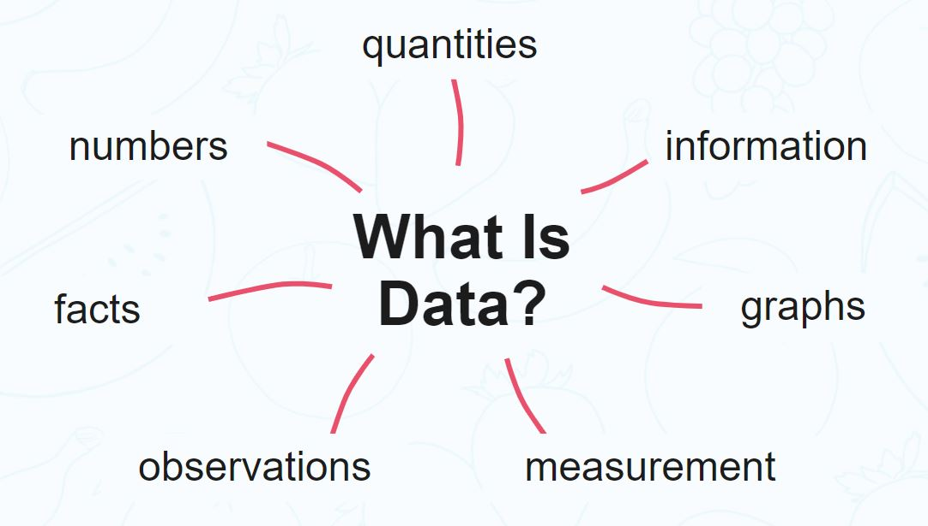
What is data?
Data is fundamentally inert and has no real meaning or value until we analyze it.

Slide 6
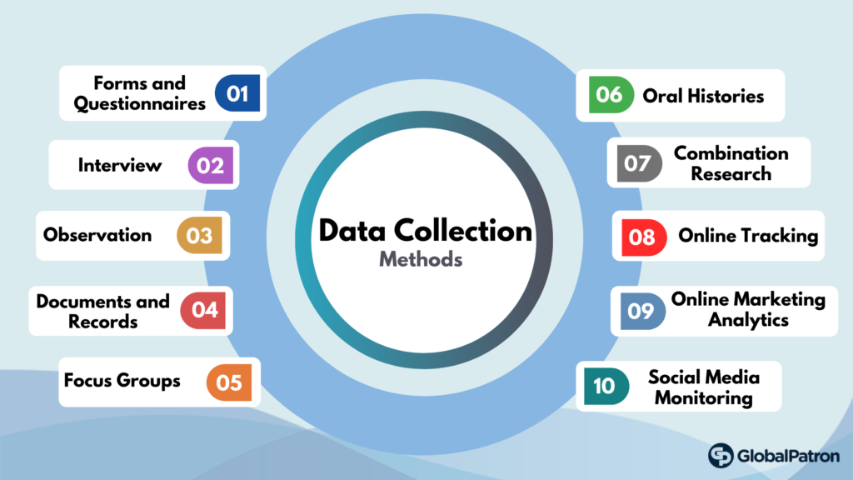
Data Collection Methods

Slide 7
Type of data
Data can be qualitative or quantitative.
Qualitative data
This refers to data that can be observed and recorded. It is non-numerical in nature. This type of data is collected through methods of observations, survey, opinion of people on a particular topic, and similar methods. Examples of qualitative data include gender, opinion, blood type, country of origin, and so on. Qualitative data is often known as categorical data.

Slide 8
Type of data
Data can be qualitative or quantitative.
Quantitative data
Quantitative data is the type of data that can be measured in the form of numbers or counts. Quantitative data can be used to answer questions such as “How many?”, “How often?”, “How much?”.

Slide 9
Type of quantitative data
Quantitative data can be divided into two discrete and continuous data.
Discrete data
Discrete data is a type of data that consists of counting numbers only. Examples include the number of students taking this course, the number of days in a year, number of females in South Sudan, number of calls you received in a day. You can identify discrete data by asking the following questions: Can it be counted? Can it be divided into smaller parts?

Slide 10
Type of quantitative data
Quantitative data can be divided into two discrete and continuous data.
Continuous data
Continuous data is a type of data that arise as a result of measurement. It has an infinite number of possible values within a given range. Example of continuous data includes height, weight, temperature and length.

Slide 11
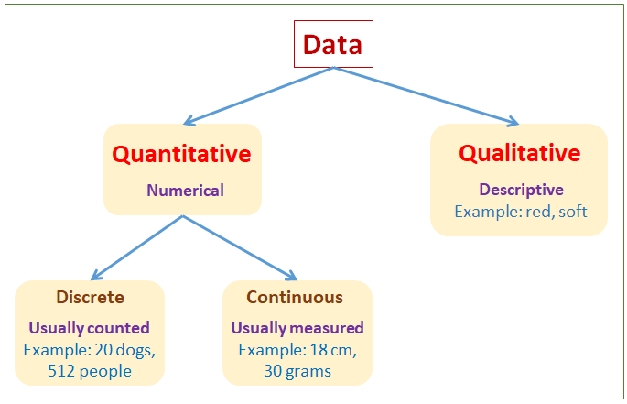
Summary

Slide 12


